Slide 1

Welcome
The following presentation will guide you through a training on how to prepare your mind for the upcoming experience

Slide 2
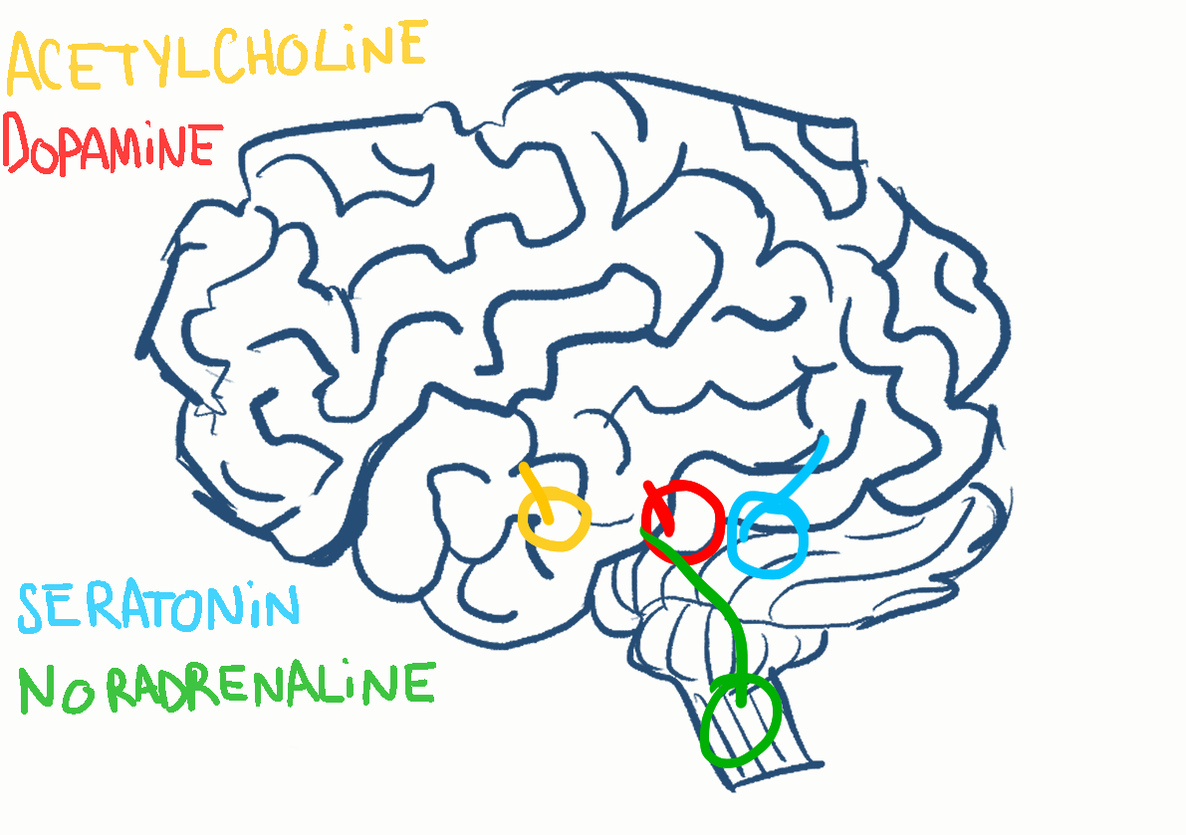
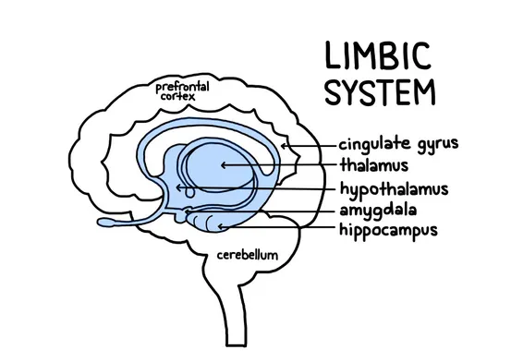

Notes:
Intro 1
Your brain has the ability to turn pain up or down. The higher brain centers that register your thoughts and feelings send nerve fibers down to your spinal cord, where they can increase or decrease pain. With the right kind of mindset, your brain can release chemicals that change pain. For example, it can cause the release of opioids, natural pain-relieving chemicals. Morphine and other painkillers are opioids, too. They work by tapping into your brain’s opioid system; but the machinery in your brain for changing pain is already there.
Your mindset changes the experience of pain, by changing pain-related signals coming up to the brain from your spinal cord.
Some common strategies, like distraction or trying to ignore pain, may be helpful in some circumstances. But often, pain commands your attention. And so distraction doesn’t always work.
We are going to teach you a different strategy, which might work in different ways than you think. For this study we want you to let go of any ideas you might have about how to control pain, and try out the strategy we are going to teach you.

Slide 3


commands
distraction
Notes:
Your mindset changes the experience of pain, by changing pain-related signals coming up to the brain from your spinal cord. Some common strategies, like distraction or trying to ignore pain, may be helpful in some circumstances. But often, pain commands your attention. And so, distraction doesn’t always work.

Slide 4


Let Go
Notes:
We are going to teach you a different strategy, which might work in different ways than you think. For this study we want you to let go of any ideas you might have about how to control pain and try out the strategy we are going to teach you.

Slide 5
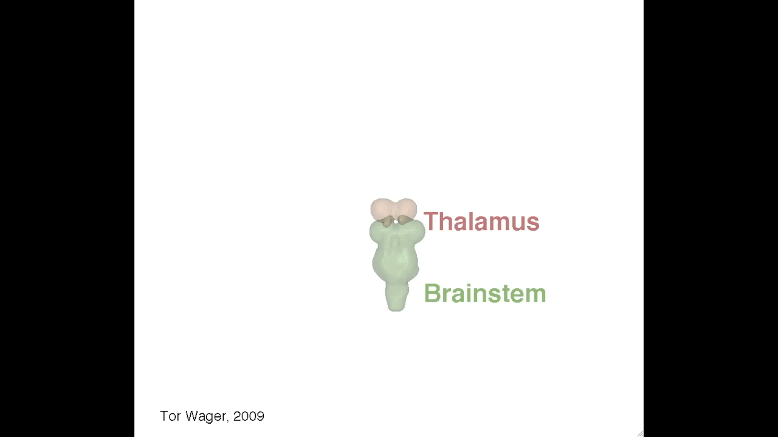

Slide 6
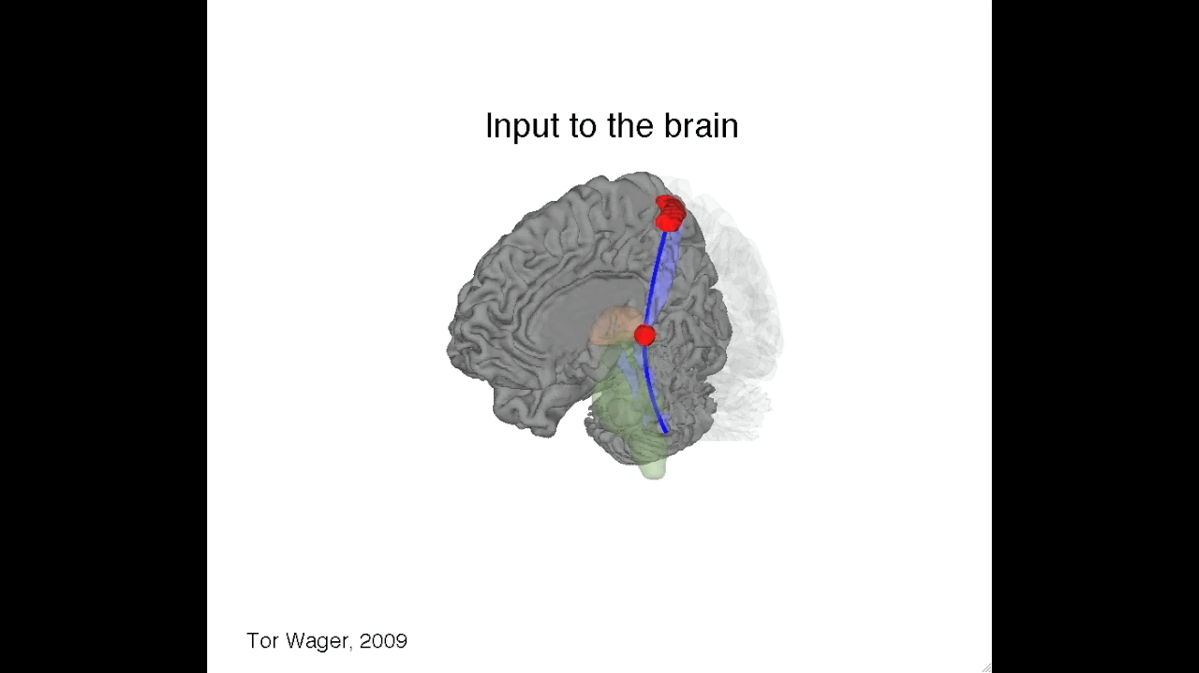

Slide 7

believes
Notes:
Intro 2
A big part of whether the brain reduces or amplifies pain is about what it ‘believes’ the pain means. One of the things that can increase pain is the feeling that the pain is “wrong,” or “unacceptable,” and the sense of urgency that goes with that. If you feel like you must do something about the pain, but you can’t, that is a very bad feeling. So, the big part of the badness of pain is caused by the sense of urgency to do something about it, to avoid it. If you feel the urgency to avoid the experience, it may make the experience worse. It may also make it harder to control.
On the other hand, things that can reduce pain are thoughts of openness and acceptance - realizing that you don’t always have to experience these sensations as unpleasant. So, the feeling that the pain is “okay” and “acceptable” can decrease pain. It will reduce the sense of urgency: For example, even if I experience pain, it is okay. It is not going to damage my skin or finger, so I don’t need to react to it or worry about it.

Slide 8
wrong
urgency
Notes:
Intro 2
A big part of whether the brain reduces or amplifies pain is about what it ‘believes’ the pain means. One of the things that can increase pain is the feeling that the pain is “wrong,” or “unacceptable,” and the sense of urgency that goes with that. If you feel like you must do something about the pain, but you can’t, that is a very bad feeling. So, the big part of the badness of pain is caused by the sense of urgency to do something about it, to avoid it. If you feel the urgency to avoid the experience, it may make the experience worse. It may also make it harder to control.
On the other hand, things that can reduce pain are thoughts of openness and acceptance - realizing that you don’t always have to experience these sensations as unpleasant. So, the feeling that the pain is “okay” and “acceptable” can decrease pain. It will reduce the sense of urgency: For example, even if I experience pain, it is okay. It is not going to damage my skin or finger, so I don’t need to react to it or worry about it.

Slide 9

avoidance
Notes:
Intro 2
A big part of whether the brain reduces or amplifies pain is about what it ‘believes’ the pain means. One of the things that can increase pain is the feeling that the pain is “wrong,” or “unacceptable,” and the sense of urgency that goes with that. If you feel like you must do something about the pain, but you can’t, that is a very bad feeling. So, the big part of the badness of pain is caused by the sense of urgency to do something about it, to avoid it. If you feel the urgency to avoid the experience, it may make the experience worse. It may also make it harder to control.
On the other hand, things that can reduce pain are thoughts of openness and acceptance - realizing that you don’t always have to experience these sensations as unpleasant. So, the feeling that the pain is “okay” and “acceptable” can decrease pain. It will reduce the sense of urgency: For example, even if I experience pain, it is okay. It is not going to damage my skin or finger, so I don’t need to react to it or worry about it.

Slide 10
openness
acceptance
Notes:
Intro 2
A big part of whether the brain reduces or amplifies pain is about what it ‘believes’ the pain means. One of the things that can increase pain is the feeling that the pain is “wrong,” or “unacceptable,” and the sense of urgency that goes with that. If you feel like you must do something about the pain, but you can’t, that is a very bad feeling. So, the big part of the badness of pain is caused by the sense of urgency to do something about it, to avoid it. If you feel the urgency to avoid the experience, it may make the experience worse. It may also make it harder to control.
On the other hand, things that can reduce pain are thoughts of openness and acceptance - realizing that you don’t always have to experience these sensations as unpleasant. So, the feeling that the pain is “okay” and “acceptable” can decrease pain. It will reduce the sense of urgency: For example, even if I experience pain, it is okay. It is not going to damage my skin or finger, so I don’t need to react to it or worry about it.

Slide 11
reduced urgency

Slide 12
Three parts:
Notes:
We will explain the Regulation strategy in more detail now and then train this Regulation

Slide 13

receptive
focus
#1) prepare

Slide 14
#2) acceptance

Slide 15

#3) transforming

Slide 16
acceptance
discordant
transformation
harmonious
Notes:
Intro 3
Strategy (record audio + display text on screen)
In the training you’re going to learn today, there are three parts: preparation, acceptance, and transformation.
The first part will PREPARE your body and mind for the upcoming session. You will let go of your everyday thoughts and bodily sensations to experience something new. You will practice to focus on the connection between mind & body, with your full attention. This will make your mind both receptive and in control, and therefore better able to practice the acceptance strategy.
In the second part you will practice adopting an attitude of ACCEPTANCE, in which you focus on purely experiencing the sensations we give you, so accept them as sensations that will pass, and do not try to fight or avoid them.
Finally, you will practice TRANSFORMING the quality of the sensation you are experiencing. This is a practice in mental flexibility.
To illustrate what we mean by ACCEPTANCE and TRANSFORMATION, let’s imagine a musical note being played by different instruments. Depending on whether this note is played by a trumpet [[ play note ]] or a piano [[ play note ]] this same note can sound very different. Also, the overall sound depends on what else is being played at the same time –the note can be played together with others that make it harmonious and pleasant, or discordant and unpleasant. [[ play examples]]. This means that depending on the context, you can experience the same musical note in different ways.
Similarly, in our study today we are going to give you some sensations, which most people ordinarily experience as painful, though they do not have to be. Like musical notes, these sensations can be more or less pleasant or unpleasant depending on what else is happening in your mind and brain. You will practice accepting whatever sensations you feel, to absorb them and harmonize with them. You are also going to practice transforming the quality of these sensations towards an experience that is more pleasant to you.
In this session, keep these following four ideas in your mind when you experience these sensations.
1. This will pass
2. This will not hurt my body; it does not mean anything bad for me in the future
3. My ability to handle it will make me stronger
4. It is an opportunity to practice acceptance and get better and better at it.
We’ll do this practice here in an experimental setting, but the principles are very similar to strategies that people are using to deal with real clinical pain, anxiety, and fear in real life.
There is one more point: Everything you do or think gets “stamped in” to your brain over time. Every thought and action gets easier and, eventually, more automatic as you continue to do it. So every kind of mental training is a practice, just like this training we are doing here today. It may be easy for you, or it may seem hard at first. The key is to find what works for you, and practice it. Do not worry right now about how well you can do any of these phases. Like with any practice, you will gain more & more control over time over your ability to transform and shape these experiences.

Slide 17

Pleasant
pain
Unpleasant
acceptance
transforming
Notes:
Intro 3
Strategy (record audio + display text on screen)
In the training you’re going to learn today, there are three parts: preparation, acceptance, and transformation.
The first part will PREPARE your body and mind for the upcoming session. You will let go of your everyday thoughts and bodily sensations to experience something new. You will practice to focus on the connection between mind & body, with your full attention. This will make your mind both receptive and in control, and therefore better able to practice the acceptance strategy.
In the second part you will practice adopting an attitude of ACCEPTANCE, in which you focus on purely experiencing the sensations we give you, so accept them as sensations that will pass, and do not try to fight or avoid them.
Finally, you will practice TRANSFORMING the quality of the sensation you are experiencing. This is a practice in mental flexibility.
To illustrate what we mean by ACCEPTANCE and TRANSFORMATION, let’s imagine a musical note being played by different instruments. Depending on whether this note is played by a trumpet [[ play note ]] or a piano [[ play note ]] this same note can sound very different. Also, the overall sound depends on what else is being played at the same time –the note can be played together with others that make it harmonious and pleasant, or discordant and unpleasant. [[ play examples]]. This means that depending on the context, you can experience the same musical note in different ways.
Similarly, in our study today we are going to give you some sensations, which most people ordinarily experience as painful, though they do not have to be. Like musical notes, these sensations can be more or less pleasant or unpleasant depending on what else is happening in your mind and brain. You will practice accepting whatever sensations you feel, to absorb them and harmonize with them. You are also going to practice transforming the quality of these sensations towards an experience that is more pleasant to you.
In this session, keep these following four ideas in your mind when you experience these sensations.
1. This will pass
2. This will not hurt my body; it does not mean anything bad for me in the future
3. My ability to handle it will make me stronger
4. It is an opportunity to practice acceptance and get better and better at it.
We’ll do this practice here in an experimental setting, but the principles are very similar to strategies that people are using to deal with real clinical pain, anxiety, and fear in real life.
There is one more point: Everything you do or think gets “stamped in” to your brain over time. Every thought and action gets easier and, eventually, more automatic as you continue to do it. So every kind of mental training is a practice, just like this training we are doing here today. It may be easy for you, or it may seem hard at first. The key is to find what works for you, and practice it. Do not worry right now about how well you can do any of these phases. Like with any practice, you will gain more & more control over time over your ability to transform and shape these experiences.

Slide 18
Four ideas
Notes:
Intro 3
Strategy (record audio + display text on screen)
In the training you’re going to learn today, there are three parts: preparation, acceptance, and transformation.
The first part will PREPARE your body and mind for the upcoming session. You will let go of your everyday thoughts and bodily sensations to experience something new. You will practice to focus on the connection between mind & body, with your full attention. This will make your mind both receptive and in control, and therefore better able to practice the acceptance strategy.
In the second part you will practice adopting an attitude of ACCEPTANCE, in which you focus on purely experiencing the sensations we give you, so accept them as sensations that will pass, and do not try to fight or avoid them.
Finally, you will practice TRANSFORMING the quality of the sensation you are experiencing. This is a practice in mental flexibility.
To illustrate what we mean by ACCEPTANCE and TRANSFORMATION, let’s imagine a musical note being played by different instruments. Depending on whether this note is played by a trumpet [[ play note ]] or a piano [[ play note ]] this same note can sound very different. Also, the overall sound depends on what else is being played at the same time –the note can be played together with others that make it harmonious and pleasant, or discordant and unpleasant. [[ play examples]]. This means that depending on the context, you can experience the same musical note in different ways.
Similarly, in our study today we are going to give you some sensations, which most people ordinarily experience as painful, though they do not have to be. Like musical notes, these sensations can be more or less pleasant or unpleasant depending on what else is happening in your mind and brain. You will practice accepting whatever sensations you feel, to absorb them and harmonize with them. You are also going to practice transforming the quality of these sensations towards an experience that is more pleasant to you.
In this session, keep these following four ideas in your mind when you experience these sensations.
1. This will pass
2. This will not hurt my body; it does not mean anything bad for me in the future
3. My ability to handle it will make me stronger
4. It is an opportunity to practice acceptance and get better and better at it.
We’ll do this practice here in an experimental setting, but the principles are very similar to strategies that people are using to deal with real clinical pain, anxiety, and fear in real life.
There is one more point: Everything you do or think gets “stamped in” to your brain over time. Every thought and action gets easier and, eventually, more automatic as you continue to do it. So every kind of mental training is a practice, just like this training we are doing here today. It may be easy for you, or it may seem hard at first. The key is to find what works for you, and practice it. Do not worry right now about how well you can do any of these phases. Like with any practice, you will gain more & more control over time over your ability to transform and shape these experiences.

Slide 19
1. This will pass
Notes:
Intro 3
Strategy (record audio + display text on screen)
In the training you’re going to learn today, there are three parts: preparation, acceptance, and transformation.
The first part will PREPARE your body and mind for the upcoming session. You will let go of your everyday thoughts and bodily sensations to experience something new. You will practice to focus on the connection between mind & body, with your full attention. This will make your mind both receptive and in control, and therefore better able to practice the acceptance strategy.
In the second part you will practice adopting an attitude of ACCEPTANCE, in which you focus on purely experiencing the sensations we give you, so accept them as sensations that will pass, and do not try to fight or avoid them.
Finally, you will practice TRANSFORMING the quality of the sensation you are experiencing. This is a practice in mental flexibility.
To illustrate what we mean by ACCEPTANCE and TRANSFORMATION, let’s imagine a musical note being played by different instruments. Depending on whether this note is played by a trumpet [[ play note ]] or a piano [[ play note ]] this same note can sound very different. Also, the overall sound depends on what else is being played at the same time –the note can be played together with others that make it harmonious and pleasant, or discordant and unpleasant. [[ play examples]]. This means that depending on the context, you can experience the same musical note in different ways.
Similarly, in our study today we are going to give you some sensations, which most people ordinarily experience as painful, though they do not have to be. Like musical notes, these sensations can be more or less pleasant or unpleasant depending on what else is happening in your mind and brain. You will practice accepting whatever sensations you feel, to absorb them and harmonize with them. You are also going to practice transforming the quality of these sensations towards an experience that is more pleasant to you.
In this session, keep these following four ideas in your mind when you experience these sensations.
1. This will pass
2. This will not hurt my body; it does not mean anything bad for me in the future
3. My ability to handle it will make me stronger
4. It is an opportunity to practice acceptance and get better and better at it.
We’ll do this practice here in an experimental setting, but the principles are very similar to strategies that people are using to deal with real clinical pain, anxiety, and fear in real life.
There is one more point: Everything you do or think gets “stamped in” to your brain over time. Every thought and action gets easier and, eventually, more automatic as you continue to do it. So every kind of mental training is a practice, just like this training we are doing here today. It may be easy for you, or it may seem hard at first. The key is to find what works for you, and practice it. Do not worry right now about how well you can do any of these phases. Like with any practice, you will gain more & more control over time over your ability to transform and shape these experiences.

Slide 20
2. This will not hurt my body; it does not mean anything bad for me in the future
Notes:
Intro 3
Strategy (record audio + display text on screen)
In the training you’re going to learn today, there are three parts: preparation, acceptance, and transformation.
The first part will PREPARE your body and mind for the upcoming session. You will let go of your everyday thoughts and bodily sensations to experience something new. You will practice to focus on the connection between mind & body, with your full attention. This will make your mind both receptive and in control, and therefore better able to practice the acceptance strategy.
In the second part you will practice adopting an attitude of ACCEPTANCE, in which you focus on purely experiencing the sensations we give you, so accept them as sensations that will pass, and do not try to fight or avoid them.
Finally, you will practice TRANSFORMING the quality of the sensation you are experiencing. This is a practice in mental flexibility.
To illustrate what we mean by ACCEPTANCE and TRANSFORMATION, let’s imagine a musical note being played by different instruments. Depending on whether this note is played by a trumpet [[ play note ]] or a piano [[ play note ]] this same note can sound very different. Also, the overall sound depends on what else is being played at the same time –the note can be played together with others that make it harmonious and pleasant, or discordant and unpleasant. [[ play examples]]. This means that depending on the context, you can experience the same musical note in different ways.
Similarly, in our study today we are going to give you some sensations, which most people ordinarily experience as painful, though they do not have to be. Like musical notes, these sensations can be more or less pleasant or unpleasant depending on what else is happening in your mind and brain. You will practice accepting whatever sensations you feel, to absorb them and harmonize with them. You are also going to practice transforming the quality of these sensations towards an experience that is more pleasant to you.
In this session, keep these following four ideas in your mind when you experience these sensations.
1. This will pass
2. This will not hurt my body; it does not mean anything bad for me in the future
3. My ability to handle it will make me stronger
4. It is an opportunity to practice acceptance and get better and better at it.
We’ll do this practice here in an experimental setting, but the principles are very similar to strategies that people are using to deal with real clinical pain, anxiety, and fear in real life.
There is one more point: Everything you do or think gets “stamped in” to your brain over time. Every thought and action gets easier and, eventually, more automatic as you continue to do it. So every kind of mental training is a practice, just like this training we are doing here today. It may be easy for you, or it may seem hard at first. The key is to find what works for you, and practice it. Do not worry right now about how well you can do any of these phases. Like with any practice, you will gain more & more control over time over your ability to transform and shape these experiences.

Slide 21
3. My ability to handle this will make me stronger
Notes:
Intro 3
Strategy (record audio + display text on screen)
In the training you’re going to learn today, there are three parts: preparation, acceptance, and transformation.
The first part will PREPARE your body and mind for the upcoming session. You will let go of your everyday thoughts and bodily sensations to experience something new. You will practice to focus on the connection between mind & body, with your full attention. This will make your mind both receptive and in control, and therefore better able to practice the acceptance strategy.
In the second part you will practice adopting an attitude of ACCEPTANCE, in which you focus on purely experiencing the sensations we give you, so accept them as sensations that will pass, and do not try to fight or avoid them.
Finally, you will practice TRANSFORMING the quality of the sensation you are experiencing. This is a practice in mental flexibility.
To illustrate what we mean by ACCEPTANCE and TRANSFORMATION, let’s imagine a musical note being played by different instruments. Depending on whether this note is played by a trumpet [[ play note ]] or a piano [[ play note ]] this same note can sound very different. Also, the overall sound depends on what else is being played at the same time –the note can be played together with others that make it harmonious and pleasant, or discordant and unpleasant. [[ play examples]]. This means that depending on the context, you can experience the same musical note in different ways.
Similarly, in our study today we are going to give you some sensations, which most people ordinarily experience as painful, though they do not have to be. Like musical notes, these sensations can be more or less pleasant or unpleasant depending on what else is happening in your mind and brain. You will practice accepting whatever sensations you feel, to absorb them and harmonize with them. You are also going to practice transforming the quality of these sensations towards an experience that is more pleasant to you.
In this session, keep these following four ideas in your mind when you experience these sensations.
1. This will pass
2. This will not hurt my body; it does not mean anything bad for me in the future
3. My ability to handle it will make me stronger
4. It is an opportunity to practice acceptance and get better and better at it.
We’ll do this practice here in an experimental setting, but the principles are very similar to strategies that people are using to deal with real clinical pain, anxiety, and fear in real life.
There is one more point: Everything you do or think gets “stamped in” to your brain over time. Every thought and action gets easier and, eventually, more automatic as you continue to do it. So every kind of mental training is a practice, just like this training we are doing here today. It may be easy for you, or it may seem hard at first. The key is to find what works for you, and practice it. Do not worry right now about how well you can do any of these phases. Like with any practice, you will gain more & more control over time over your ability to transform and shape these experiences.

Slide 22
4. It is an opportunity to practice acceptance and get better and better at it.
Notes:
Intro 3
Strategy (record audio + display text on screen)
In the training you’re going to learn today, there are three parts: preparation, acceptance, and transformation.
The first part will PREPARE your body and mind for the upcoming session. You will let go of your everyday thoughts and bodily sensations to experience something new. You will practice to focus on the connection between mind & body, with your full attention. This will make your mind both receptive and in control, and therefore better able to practice the acceptance strategy.
In the second part you will practice adopting an attitude of ACCEPTANCE, in which you focus on purely experiencing the sensations we give you, so accept them as sensations that will pass, and do not try to fight or avoid them.
Finally, you will practice TRANSFORMING the quality of the sensation you are experiencing. This is a practice in mental flexibility.
To illustrate what we mean by ACCEPTANCE and TRANSFORMATION, let’s imagine a musical note being played by different instruments. Depending on whether this note is played by a trumpet [[ play note ]] or a piano [[ play note ]] this same note can sound very different. Also, the overall sound depends on what else is being played at the same time –the note can be played together with others that make it harmonious and pleasant, or discordant and unpleasant. [[ play examples]]. This means that depending on the context, you can experience the same musical note in different ways.
Similarly, in our study today we are going to give you some sensations, which most people ordinarily experience as painful, though they do not have to be. Like musical notes, these sensations can be more or less pleasant or unpleasant depending on what else is happening in your mind and brain. You will practice accepting whatever sensations you feel, to absorb them and harmonize with them. You are also going to practice transforming the quality of these sensations towards an experience that is more pleasant to you.
In this session, keep these following four ideas in your mind when you experience these sensations.
1. This will pass
2. This will not hurt my body; it does not mean anything bad for me in the future
3. My ability to handle it will make me stronger
4. It is an opportunity to practice acceptance and get better and better at it.
We’ll do this practice here in an experimental setting, but the principles are very similar to strategies that people are using to deal with real clinical pain, anxiety, and fear in real life.
There is one more point: Everything you do or think gets “stamped in” to your brain over time. Every thought and action gets easier and, eventually, more automatic as you continue to do it. So every kind of mental training is a practice, just like this training we are doing here today. It may be easy for you, or it may seem hard at first. The key is to find what works for you, and practice it. Do not worry right now about how well you can do any of these phases. Like with any practice, you will gain more & more control over time over your ability to transform and shape these experiences.

Slide 23
Notes:
Intro 3
Strategy (record audio + display text on screen)
In the training you’re going to learn today, there are three parts: preparation, acceptance, and transformation.
The first part will PREPARE your body and mind for the upcoming session. You will let go of your everyday thoughts and bodily sensations to experience something new. You will practice to focus on the connection between mind & body, with your full attention. This will make your mind both receptive and in control, and therefore better able to practice the acceptance strategy.
In the second part you will practice adopting an attitude of ACCEPTANCE, in which you focus on purely experiencing the sensations we give you, so accept them as sensations that will pass, and do not try to fight or avoid them.
Finally, you will practice TRANSFORMING the quality of the sensation you are experiencing. This is a practice in mental flexibility.
To illustrate what we mean by ACCEPTANCE and TRANSFORMATION, let’s imagine a musical note being played by different instruments. Depending on whether this note is played by a trumpet [[ play note ]] or a piano [[ play note ]] this same note can sound very different. Also, the overall sound depends on what else is being played at the same time –the note can be played together with others that make it harmonious and pleasant, or discordant and unpleasant. [[ play examples]]. This means that depending on the context, you can experience the same musical note in different ways.
Similarly, in our study today we are going to give you some sensations, which most people ordinarily experience as painful, though they do not have to be. Like musical notes, these sensations can be more or less pleasant or unpleasant depending on what else is happening in your mind and brain. You will practice accepting whatever sensations you feel, to absorb them and harmonize with them. You are also going to practice transforming the quality of these sensations towards an experience that is more pleasant to you.
In this session, keep these following four ideas in your mind when you experience these sensations.
1. This will pass
2. This will not hurt my body; it does not mean anything bad for me in the future
3. My ability to handle it will make me stronger
4. It is an opportunity to practice acceptance and get better and better at it.
We’ll do this practice here in an experimental setting, but the principles are very similar to strategies that people are using to deal with real clinical pain, anxiety, and fear in real life.
There is one more point: Everything you do or think gets “stamped in” to your brain over time. Every thought and action gets easier and, eventually, more automatic as you continue to do it. So every kind of mental training is a practice, just like this training we are doing here today. It may be easy for you, or it may seem hard at first. The key is to find what works for you, and practice it. Do not worry right now about how well you can do any of these phases. Like with any practice, you will gain more & more control over time over your ability to transform and shape these experiences.

Slide 24
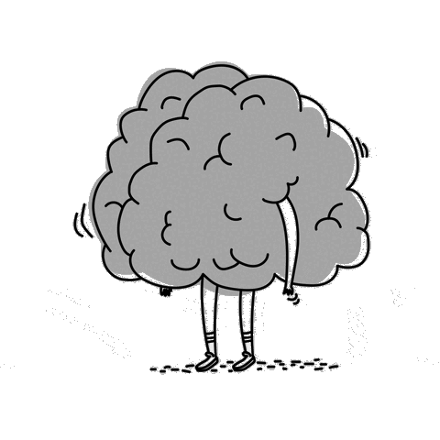
Notes:
Intro 3
Strategy (record audio + display text on screen)
In the training you’re going to learn today, there are three parts: preparation, acceptance, and transformation.
The first part will PREPARE your body and mind for the upcoming session. You will let go of your everyday thoughts and bodily sensations to experience something new. You will practice to focus on the connection between mind & body, with your full attention. This will make your mind both receptive and in control, and therefore better able to practice the acceptance strategy.
In the second part you will practice adopting an attitude of ACCEPTANCE, in which you focus on purely experiencing the sensations we give you, so accept them as sensations that will pass, and do not try to fight or avoid them.
Finally, you will practice TRANSFORMING the quality of the sensation you are experiencing. This is a practice in mental flexibility.
To illustrate what we mean by ACCEPTANCE and TRANSFORMATION, let’s imagine a musical note being played by different instruments. Depending on whether this note is played by a trumpet [[ play note ]] or a piano [[ play note ]] this same note can sound very different. Also, the overall sound depends on what else is being played at the same time –the note can be played together with others that make it harmonious and pleasant, or discordant and unpleasant. [[ play examples]]. This means that depending on the context, you can experience the same musical note in different ways.
Similarly, in our study today we are going to give you some sensations, which most people ordinarily experience as painful, though they do not have to be. Like musical notes, these sensations can be more or less pleasant or unpleasant depending on what else is happening in your mind and brain. You will practice accepting whatever sensations you feel, to absorb them and harmonize with them. You are also going to practice transforming the quality of these sensations towards an experience that is more pleasant to you.
In this session, keep these following four ideas in your mind when you experience these sensations.
1. This will pass
2. This will not hurt my body; it does not mean anything bad for me in the future
3. My ability to handle it will make me stronger
4. It is an opportunity to practice acceptance and get better and better at it.
We’ll do this practice here in an experimental setting, but the principles are very similar to strategies that people are using to deal with real clinical pain, anxiety, and fear in real life.
There is one more point: Everything you do or think gets “stamped in” to your brain over time. Every thought and action gets easier and, eventually, more automatic as you continue to do it. So every kind of mental training is a practice, just like this training we are doing here today. It may be easy for you, or it may seem hard at first. The key is to find what works for you, and practice it. Do not worry right now about how well you can do any of these phases. Like with any practice, you will gain more & more control over time over your ability to transform and shape these experiences.

Slide 25
Are you ready to practice?

Slide 27
focus
let go

Slide 28
Experimenter, please attach a thermode on the left arm.
Press “Enter” once complete to continue the presentation.

Slide 29

acceptance
Notes:
Imagine the thermode burning against your pressed skin.
The ‘negative’ sensations you feel are composed of two parts. The sensory experience itself and your judgment of it, its ‘goodness’ or ‘badness.’ With acceptance, you are disengaging the brain circuits related to the ‘badness’ from the sensory experience.
Locate the sensation on your skin. Notice the sensation, but do not try to respond or react. Simply experience it for the sensation that it is. Feel how it feels pressed against your skin

Slide 30

It will pass by.
curiosity

Slide 31
3 Ways

Slide 32
Spreading warmth

Slide 33



Slide 36
Focus on your breath.
Feel your body float.
Accept the following sensations as they come.
Transform negative sensations into positive.
Tap into the feeling.
Notes:
Can you remember the feeling?
When you see the following instructions:
Focus on your breath.
Feel your body float.
Accept the following sensations as they come.
Transform negative sensations into positive.
Tap into the feeling.

